Slide 1
ElectViz – Election Data Visualization for Media
Interactive Analysis of Indian Election Data Using Microsoft Power BI

Slide 2
Introduction
Election data analysis involves studying voting patterns, voter turnout, party performance, and candidate success using data analytics tools.
Technology Used
Microsoft Power BI
Data cleaning and transformation
Interactive dashboards

Slide 3
Main Objectives of the Project
To visualize Indian election data using dashboards
To analyze voter turnout across states
To track party performance and seat distribution
To understand demographic voting trends
To provide real-time election insights

Slide 4
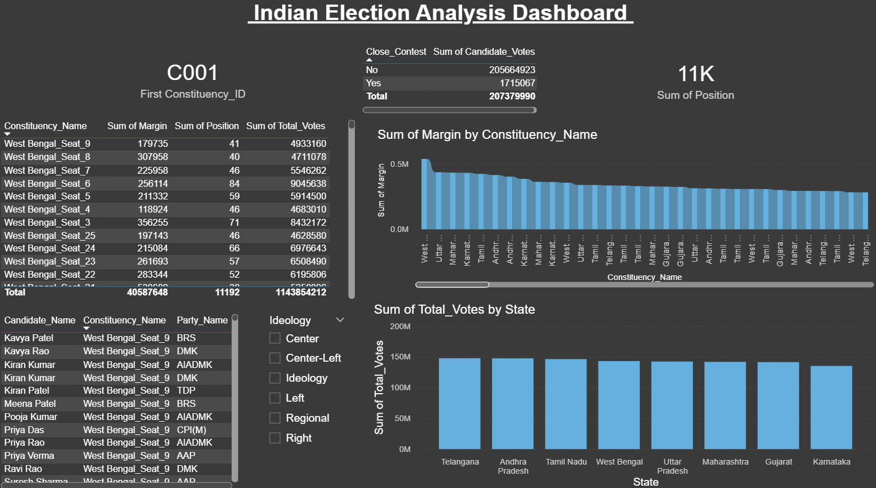
Module 1: Indian Election Analysis Dashboard
This dashboard provides an overview of the election results.
Key Visualizations:
• Total votes by state
• Margin by constituency
• Candidate and party information
• Vote distribution charts
Insights:
• Shows which states have higher voting activity
• Displays constituencies with the highest winning margin
• Helps quickly identify major parties and candidates.

Slide 5
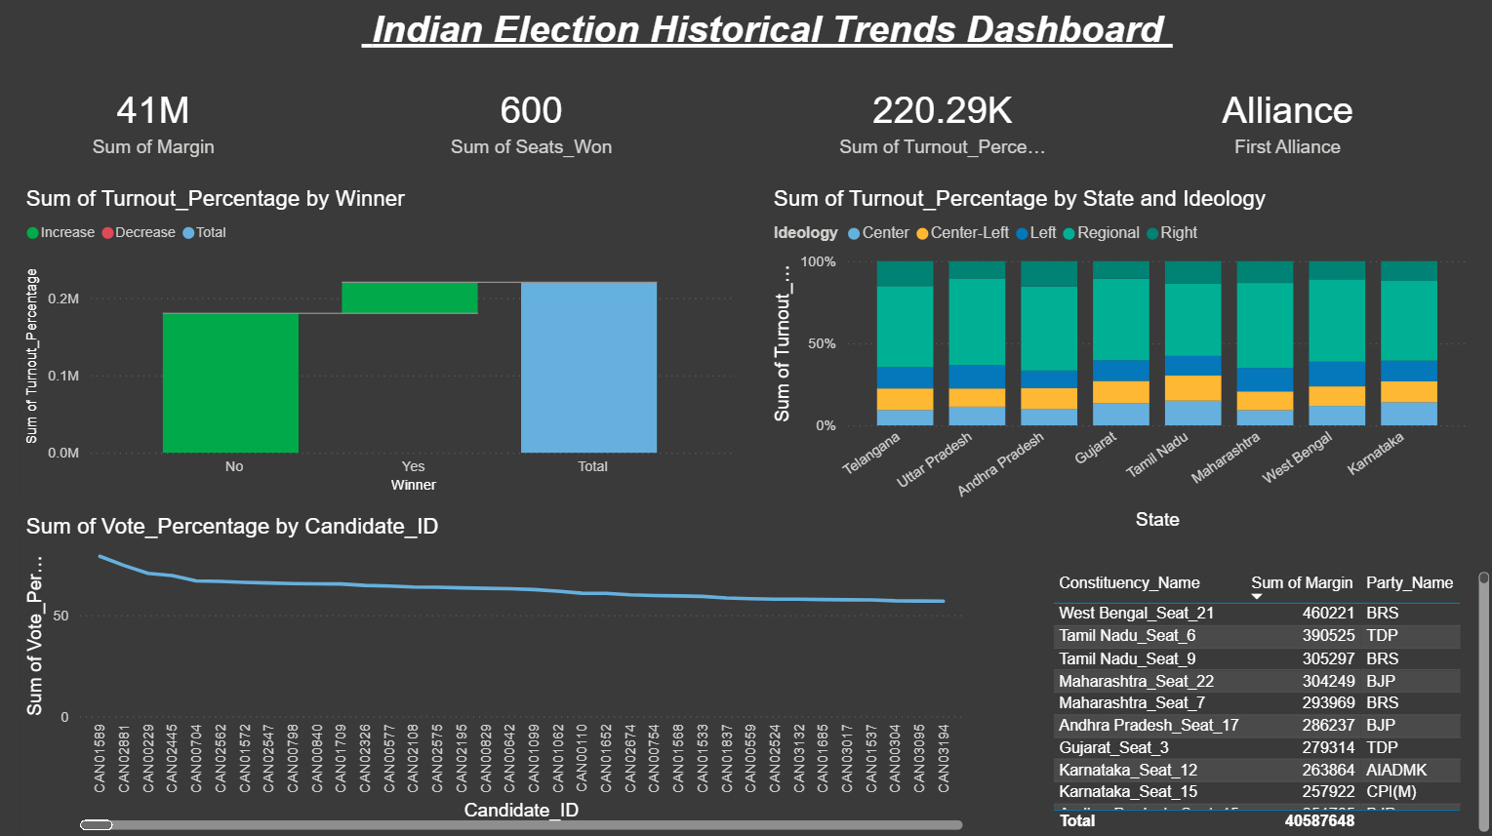
Module 2: Indian Historical Trends Dashboard
This dashboard focuses on historical election trends.
Key Metrics:
• Total seats won
• Turnout percentage trends
• Voting patterns across states
• Ideology distribution (Left, Right, Regional)
Purpose: • To understand how voting behavior and party dominance change over time.
Benefit:
• Helps analysts predict possible future trends.

Slide 6
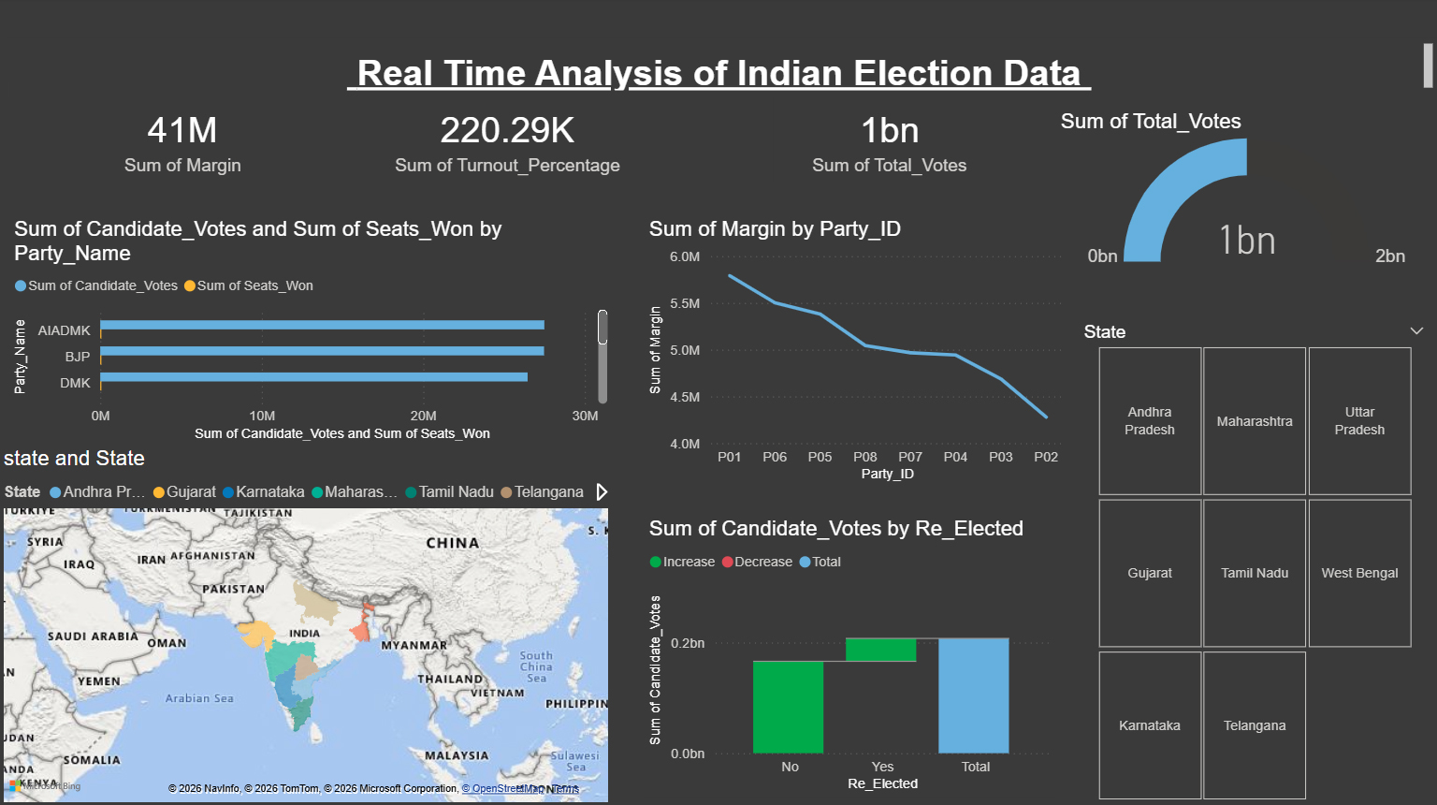
Module 3: Real-Time Election Data Analysis
This dashboard tracks election statistics dynamically.
Key Visuals:
• Total votes
• Margin comparison by party
• State-wise performance
• Re-elected candidate analysis
Insight: • Shows real-time updates of election
• performance and helps media
• organizations quickly interpret election outcomes.

Slide 7
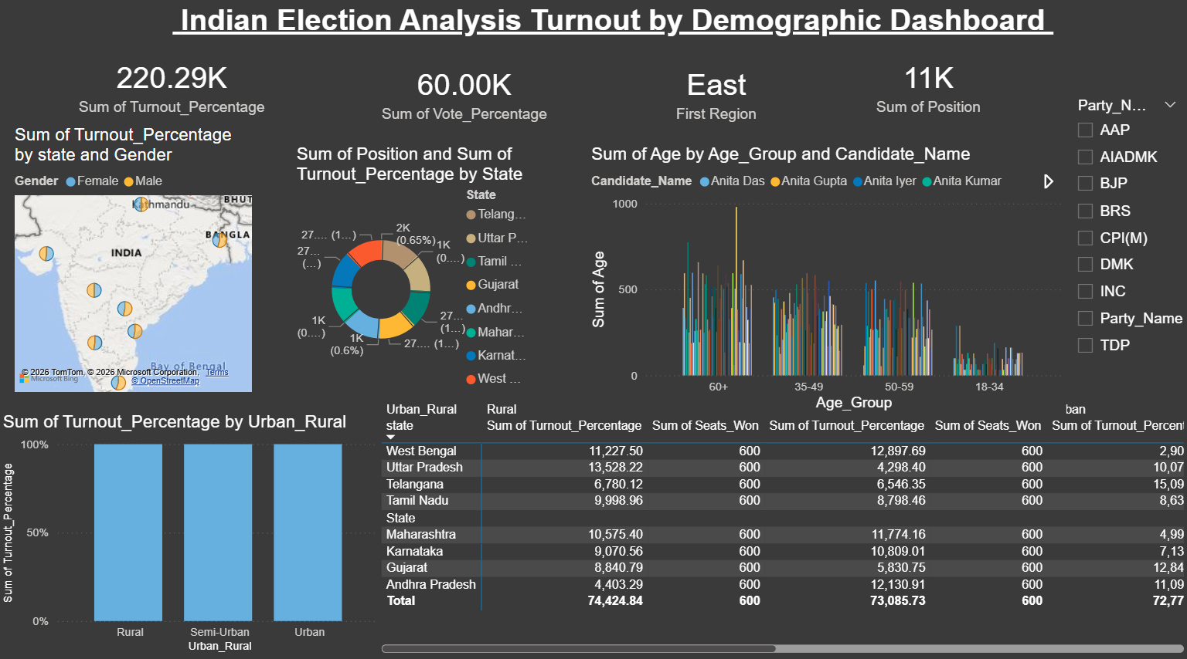
Module 4: Demographic Turnout Dashboard
This dashboard analyzes voter turnout based on demographic data.
Factors Analyzed:
• Gender (Male / Female)
• Age groups
• Urban vs Rural voters
• State-wise participation
Insights:
• Which age group votes more
• Gender participation in elections
• Differences between rural and urban turnout

Slide 8
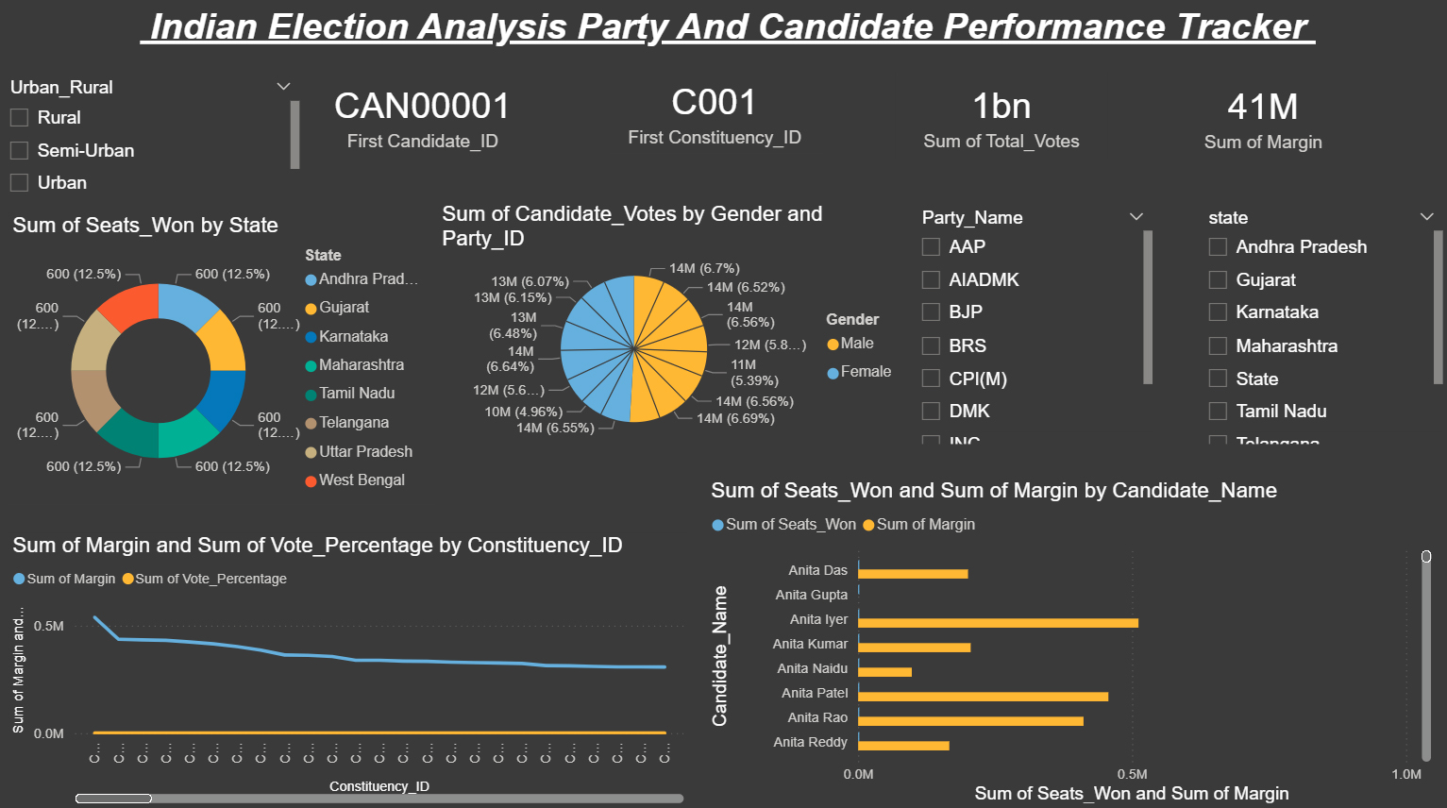
Module 5: Party & Candidate Performance Tracker
This dashboard focuses on political party and candidate performance.
Key Visualizations:
• Seats won by state
• Candidate vote share
• Party-wise performance
• Constituency-wise margins
Insights:
• Top performing candidates
• Strongest political parties
• Constituencies with close contests

Slide 9
Conclusion & Future Scope
Conclusion:
• ElectViz provides clear insights into Indian election data.
• Interactive dashboards make complex election information easier to understand.
• The project helps media analysts quickly interpret election results.
Future Scope:
• Integration with live election data
• AI-based election prediction models
• Advanced voter behavior analytics
• Mobile-friendly dashboards

Slide 10
Thank You

